Slide 1

MexE 406
Robotics 1
Engr. Mikko A. De Torres
Mechatronics Engineer
Department of Electronics Engineering
Batangas State University || College of Engineering

Slide 2
Objectives:
Introduction: 1) definition of robots, mechatronics and robotics, 2)misconceptions and 3)advance concepts
Mechanical Manipulator: 1) Definitions, 2) Anatomy and 3) Links and Joints
Types of Mechanical Manipulator
Mechanics: Degrees of Freedom (DOF)
Kinematic Diagram
Denavit-Hartenberg Notation
Robot Kinematics
Robot design and programming through coding

Slide 3
Pre-requisites:
Courses:
Mechanics
Advance Math for Mechatronics Engineering
Programming Languages:
Basic Python
MATLAB
C/C++
Co-requisites:
Electronics Measurement and Instrumentation

Slide 4
Previous Math Courses:
Arithmetic
Logic
Algebra
Trigonometry
Analytic Geometry
Solid Mensuration
Linear Systems and Algebra
Differential Equations

Slide 5
Previous Automation Courses:
Introduction to Electromechanical Systems and Automation
Pneumatics and Hydraulics Systems
Digital Principles and Logic Designs
Others:
Purposive Communication

Slide 6
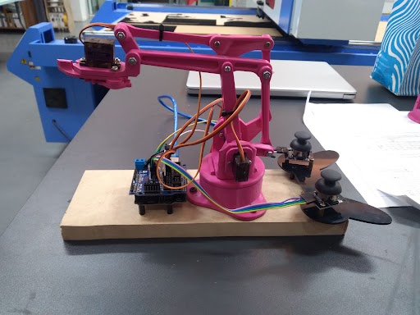
Mathematical Tools:
For coding:
VSCode for Python
MATLAB
For proof of concepts:
Drawing Materials
Graphing papers
EEzyRobotArm
ESP32 and Arduino UNO

